Slide 1
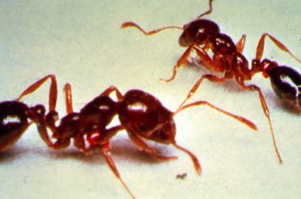
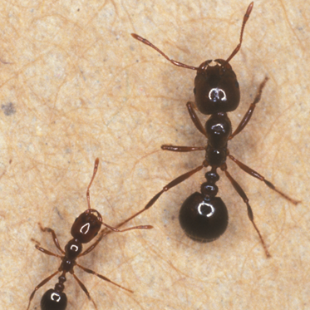
Ant
Olivia Giewat

Slide 2
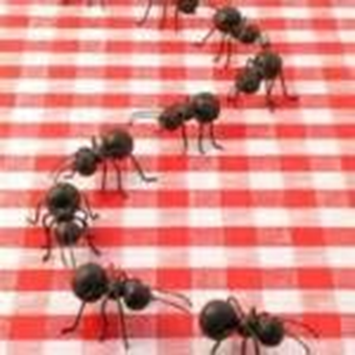
Introduction
W hen uninvited guests come to your picnic what are they? They're ants. Don't let them get close to your food.

Slide 3
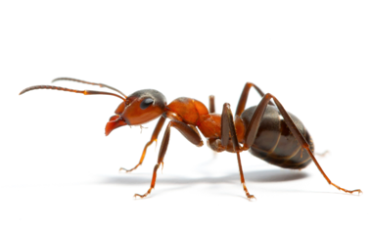
What does the ant look like?
Ants have antennas. They help the ant smell.
Ants have abdomens. Abdomens are part of the ant body.
Ants also have a thorax that is the middle of the ant body.
Ants have wings. The ants that have wings are young queens, and boys.

Slide 4
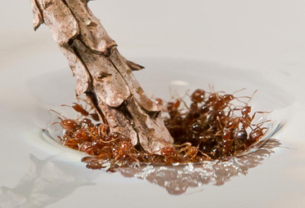
What is the ant’s habitat?
Ants live in tunnels under ground.
Ants live in mounds, and make mounds. Water does not get in because the
mounds keeps the water out.
Ants live in wood sometimes. Or they live in houses.
Ants live in dead trees.

Slide 5
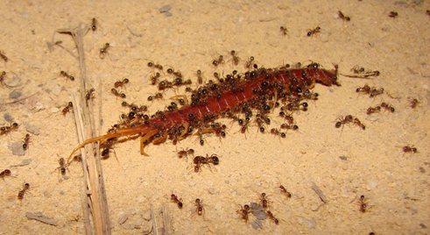
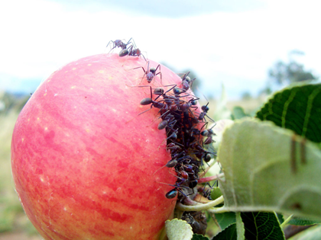
What does the ant eat and how does it hunt?
Ants eat leaves, and grass. Ants sometimes eat caterpillars.
Ants have sharp jaws so it will help them grab their prey and they drag them back so they can give it the queen ant.
Ants eat a special fungus.
Ants eat fruits, leaves, and dead insects.

Slide 6
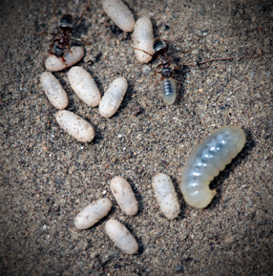
All about ant babies.
Ant babies are carried by worker ants because the babies can`t see yet, and can only swiggle.
The ant baby is born by the queen ant. The egg is white.
Baby ants are called larva.
More than one ant baby is called larvae.

Slide 7
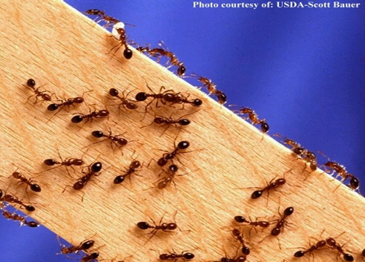
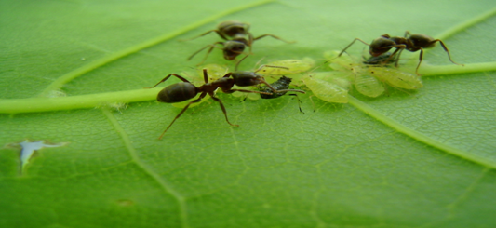
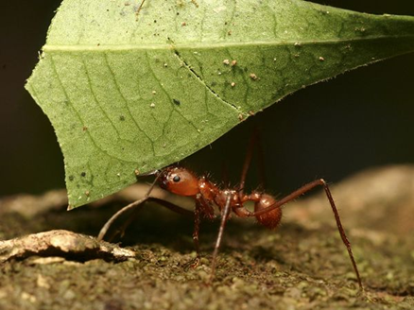
Fun facts
I learned that ant babies look like worms. Worker ants have sharp jaws.
Ants can live to 45 days to 60 days.
There are more than 2,500 kinds of ants in the world.

Slide 8
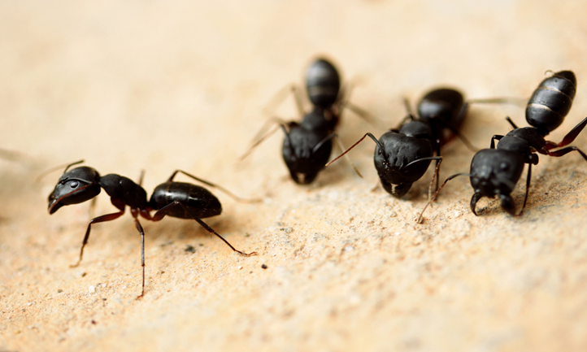
My sources
http://www.pebblego.com/content/choose_product.php
Title: Ants
Author: James.P.Rowan

