Slide 1
Honeybees
Dylan Lawton

Slide 2
Introduction
Buzzzzz…. what’s that? Yikes a bee! Let’s kill it? No wait bees are important. Let’s find out why?

Slide 3
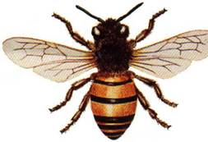
What does the Honeybee look like?
Honeybees gather nectar through their tube-like tongues. The hind legs of a honeybees have special brushes of stiff curved hairs. Female honeybees have a barbed stinger at the far end of their bodies. Honeybees are about .5 inch /1.3 inches long.

Slide 4
What is the Honeybee’s habitat?
Honeybees are found wherever flowers grow. A colony of honeybees live in a hive. A colony has a queen bee and worker bees. Worker bees gather nectar and pollen from flowers. They bring it back to the hive and turn it into honey.

Slide 5
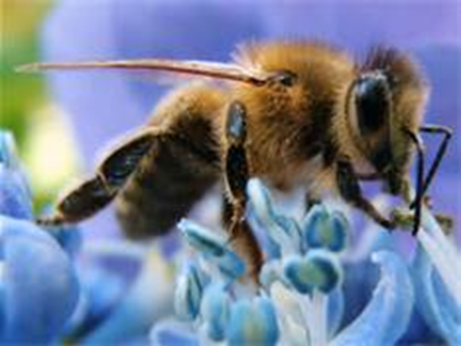
What does the Honeybee eat how does it hunt?
Honeybees make the honey first. And then they eat the honey. And they eat the nectar and pollen too.

Slide 6
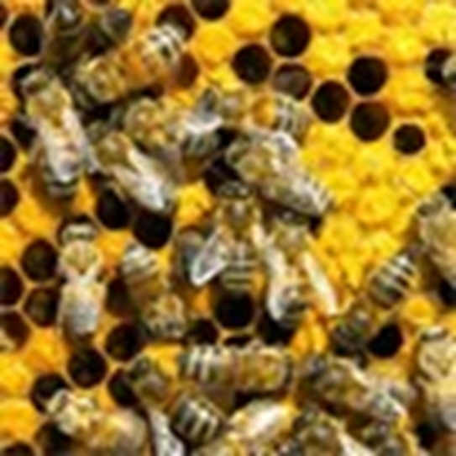
All about Honeybee babies.
First the queen bee lays eggs in the cells of the hive. The wormlike babies that hatch are called larva's. Within 5 days, they enter the pupa, or resting stage of their lives. Workers close their cells with wax.

Slide 7
My sources
Honeybee by James P Rowan
’’Pebblego.www.Pebblego.com.may31,2013.

